Slide 1
Dr.Mohammed Al-Husban

Slide 2
To make better interactive technology …. We need to:
Know about how people interact with things
Know about what people can and can’t do
Know about the situations in which people do things
Understand people’s goals
Design thinking
Problem to solution (Time, Budget, Resources)
User Needs = Value Proposition
Solution to Problem (Time, Budget, Resources)

Slide 8
HCI
“HCI researches the design and use of computer technology, focused on the interfaces between people (users) and computers. Researchers in the field of HCI both observe the ways in which humans interact with computers and design technologies that let humans interact with computers in novel ways.” Wiki

Slide 10
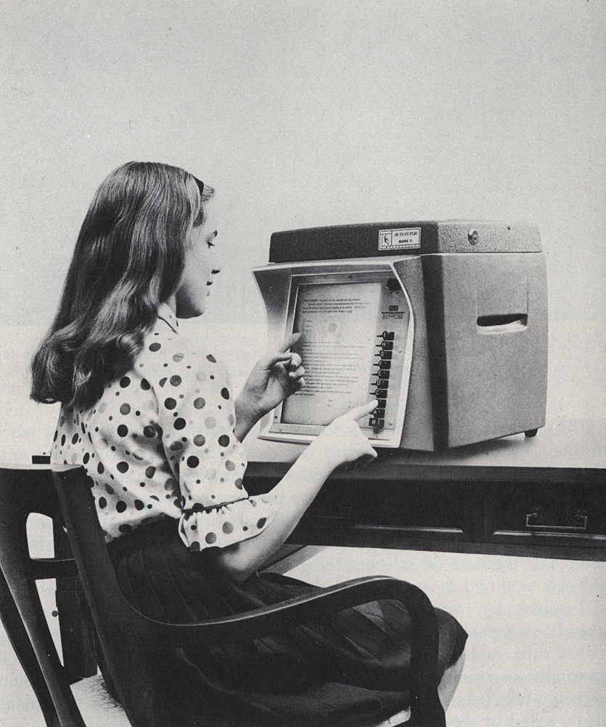
User experience design (UX, UXD, UED or XD) is the process of enhancing user satisfaction by improving the usability, accessibility, and pleasure provided in the interaction between the user and the product.

Slide 11
UX Designers ARE NOT UI Designer
Mo VS Martin

Slide 12
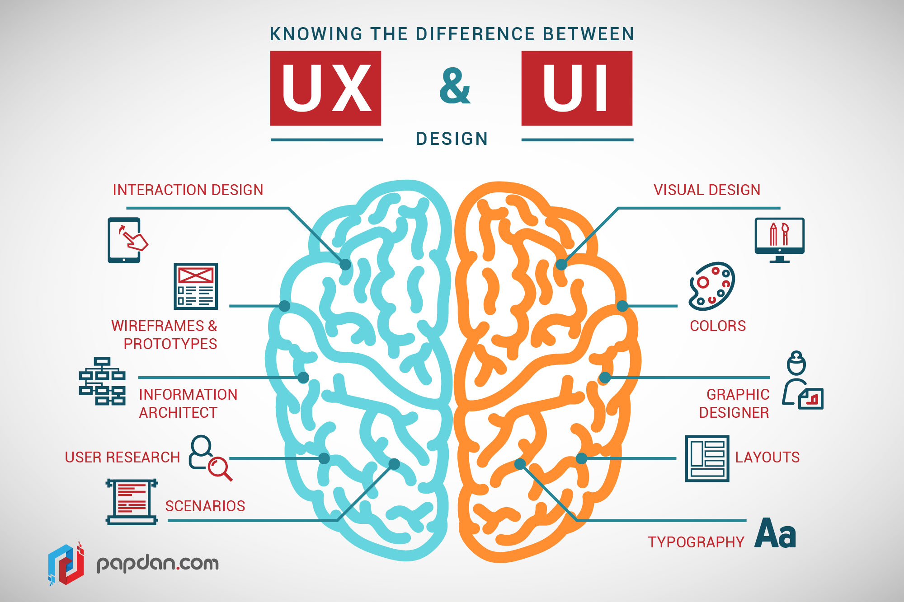

Slide 13
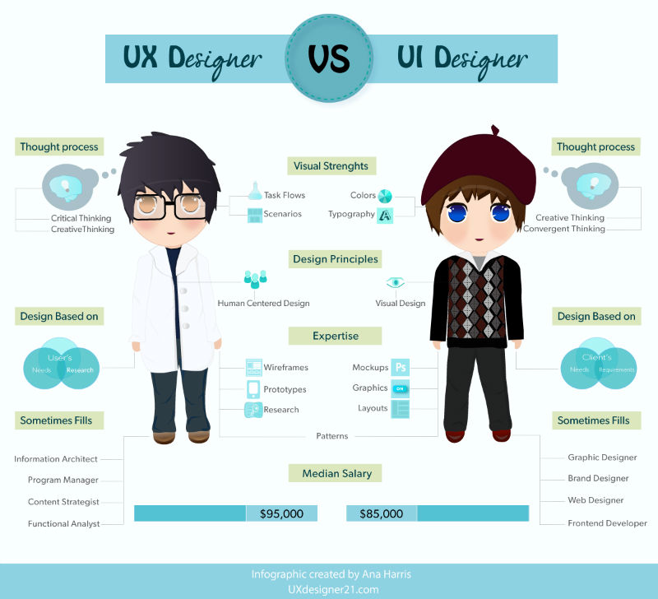

Slide 14



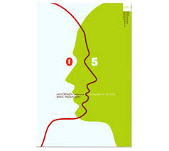

Can we all be UX Designers?

Slide 15
NO
But we can all learn things about people and design that will help us create better stuff than we would otherwise have done…

Slide 16
UX
user experience
content strategy
usability testing
user research
information architecture
interaction design

Slide 17
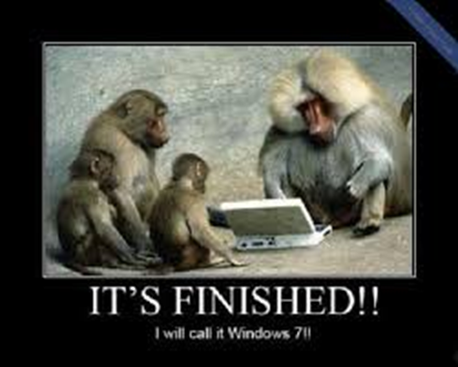
4D
is the answer, but I can’t remember the question?!!!!

Slide 18
The Plan
Discovery
Definition
Design
Development

Slide 19
Discovery
Definition
Design
Development
Stakeholder Interviews
Business Requirements
Competitive/Comparative Audit
User Research
Site Inventory
Site Map
Notes:
1. Discovery
Stakeholder interviewers, Business requirements, Competitive & Comparative Audits, User Research

Slide 20
Discovery
Definition
Design
Development
Personas
Content Audit
Card Sorts
Use Cases
Sketching
Site Map
User Journeys
Conceptual Wires/Design
Creative Brief
UX Brief
Notes:
2. Definition
Persona/Scenario Development, Content & Meta Data Audits, Use cases, Creative Brief, Mood boards

Slide 21
Discovery
Definition
Design
Development
Site Map
Content Matrix
Task Flows
Sketching
Wireframes
Stakeholder Reviews
Visual Design
Prototype
Usability Testing
Functional Specifications
Notes:
3. Design
Sitemaps, Task Flows, Wireframes, Content Strategy, Interactive Prototypes, Usability Testing, Design Comps

Slide 22
Discovery
Definition
Design
Development
Site Development
User Acceptance Testing (UAT)
Quality Assurance (QA)
Usability Testing
Notes:
4. Development
Functional Specifications, Quality Assurance Testing, Site development

Slide 23
Agile UX. VS Lean UX
Discovery
Definition
Design
Development
Stakeholder Interviews
Business Requirements
Competitive/Comparative Audit
User Research
Site Inventory
Site Map
Personas
Content Audit
Card Sorts
Use Cases
Sketching
Site Map
User Journeys
Conceptual Wires/Design
Creative Brief
UX Brief
Site Map
Content Matrix
Task Flows
Sketching
Wireframes
Stakeholder Reviews
Visual Design
Prototype
Usability Testing
Functional Specifications
Site Development
User Acceptance Testing (UAT)
Quality Assurance (QA)
Usability Testing

Slide 24
Context: Higher Education
Problem: How prospective students determine university course choice?
Users: Students
What are the factors students consider before they decide on course and university?

Slide 25
Discovery
Definition
Design
Development
Stakeholder Interviews
Business Requirements
Competitive/Comparative Audit
User Research
Site Inventory
Site Map
Personas
Content Audit
Card Sorts
Use Cases
Sketching
Site Map
User Journeys
Conceptual Wires/Design
Creative Brief
UX Brief
Site Map
Content Matrix
Task Flows
Sketching
Wireframes
Stakeholder Reviews
Visual Design
Prototype
Usability Testing
Functional Specifications
Site Development
User Acceptance Testing (UAT)
Quality Assurance (QA)
Usability Testing

Slide 26

Deliverables
discovery
definition
design
requirements document
sketches
user journeys
comparative/competitive
review
personas
site map
features/functionality
inventory
user flows
wireframes
experience brief
use cases
prototype

Slide 27
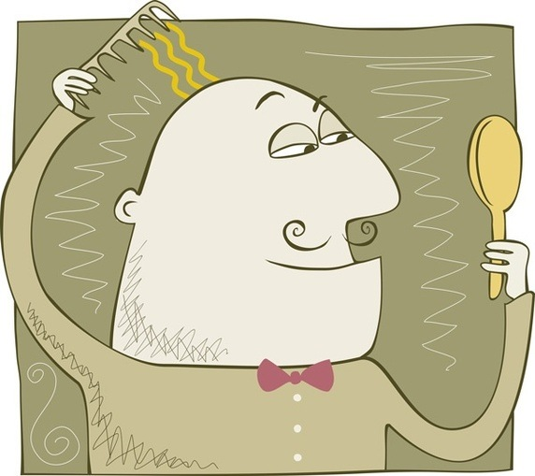
Next ….. User Research

